Slide 1
Training & Development

Slide 2
Attitudes to training
Individual:
How is that related to what I do?
“I’m good at my job and anyway, I have no time”
“I suppose that’s my weekends shot for months!”
“Are they trying to get rid of me?”
Employer:
How can I be sure the organisation will benefit?
Training is so expensive – how will I know if it has been effective?
Will this effect the goal of developing and implementing standards and protocols for the organisation?
“If I train them, they’ll leave”

Slide 3
CONCEPT OF TRAINING
Training is essentially a value-addition activity undertaken by an organization to enrich the value of its people.
It plays a vital role in enhancing the efficiency, productivity and performance of the employees.
GARY DESSELER: Training refers to the methods used to give new or present employees the skills that they need to perform their job.
The purpose of training is basically to bridge the gap between job requirements and present competencies of an employee.

Slide 4
TRAINING | DEVELOPMENT | EDUCATION/ TEACHING
APPLICATION ORIENTED | OVERALL DEV. ORIENTED. | THEORITICAL ORIENTATION
SHORT-TERM PROCESS. | CONTINUOUS, NEVER-ENDING PROCESS. | LONG-TERM PROCESS.
RELATED TO PRESENT JOB. | NOT RELATED TO ANY SPECIFIC JOB. | DIRECTED TOWARDS FUTURE OF AN INDIVIDUAL.
TRG. EFFORTS CAN BE MONITORED AND ASSESED. | DIFFICULT TO MONITOR HOW IND. IS USING THE ACQUIRED KNOWLEDGE. | DIFFICULT TO MONITOR HOW IND. IS USING THE ACQUIRED KNOWLEDGE.
RELATED TO TECHNICAL SKILLS AND LEARNING. | RELATED TO ATTITUDINAL AND BEHAVIOURAL DEV. | RELATED TO IDEOLOGY AND SOCIAL,CULTURAL VALUES.
INDIVIDUALS COME TOGETHER AND DISPERSE AFTER TRG. IS GIVEN. | FURTHER CONTACT MAY OR MAY NOT BE MAINTAINED. | SUSTAINED INTERACTION OVER A LONG PERIOD OF TIME IS POSSIBLE.

Slide 5
IMPORTANCE
OF TRG.
INCREASED
EFFICIENCY
BETTER
QUALITY OF LIFE
INCREASED
MORALE & MOTIVATION
OF EMPLOYEE
EMPLOYEE RETENTION
CAREER
ADVANCEMENT
LESS LEARNING PERIOD
ADVANCEMENT
IN TECHNOLOGY
INTRO. OF
NEW STRATEGIES
& WORKING
METHODS IN
THE ORG.
INCREASED
ORG. CAPABILITY
REDUCED
SUPERVISION & LOW ACCIDENT RATES

Slide 6
PRINCIPLES OF TRAINING
MOTIVATION
ACTIVE INVOLVEMENT
INDIVIDUAL APPROACH
SEQUENCE & STRUCTURE
FEEDBACK
TRANSFER

Slide 7
Employee Training – ADDIE Model
ADDIE Model – to develop employee training or developmental programs
Assess the need
Design the program
Develop the program
Implement the program
Evaluate the learning

Slide 8
TRAINING PROGRAMME
ASSESSING TRAINING NEEDS
JOB
Present performance Desired performance
GAP
DESIGN (TRAINING OBJECTIVE & POLICY)
Evaluation Criteria
Feedback & Revision
DEVELOPING TRAINING PROGRAMME
IMPLEMENTING THE TRAINING
EVALUATION & FOLLOW-UP

Slide 9
Phase 1: Needs Assessment for Training
A Needs Assessment is a systematic exploration of the way things are and the way they should be. These "things" are usually associated with organizational and/or individual performance .
Training needs are identified on the basis of organizational analysis, job analysis and person analysis. Training programme, training methods and course content are to be planned on the basis of training needs.

Slide 10
Need Assessment
ORGANIZATIONAL ANALYSIS
TASK ANALYSIS
PERSON ANALYSIS
…of environment, strategies, and resources to determine the needs of the organisation.
…of the roles to be performed in order to determine the KRAs needed.
…of performance, knowledge, and skills in order to determine who needs training.

Slide 11
Training Need Assesment
PERFORMANCE
DEFICIENCY
OTHER
CAUSES
LACK OF
SKILL OR
KNOWLEDGE
MOTIVATION
COUNSELLING
INCENTIVES,REWARDS,ETC.
TRAINING
ON-THE JOB OR OFF-THE JOB.

Slide 12
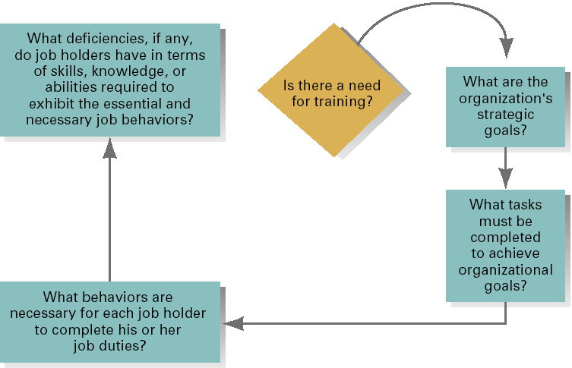
Determining if Training Is Needed

Slide 13
Phase 2: Designing the training programme
Who are the
Trainees
Who are the
Trainees
Who are the
Trainers
Who are the
Trainers
What Methods
and Techniques
What Methods
and Techniques
What Should be
the level of
training
What Should
be the level of
training
What Principles
of learning
Where to conduct
the programme
Where to
conduct
the programme

Slide 14
Phase 3: Developing T&D Programme
It includes deciding the type of training that need to be imparted
On-the-job Methods: refer to methods that are applied in the workplace and is related to employee’s working.
Off-the-job Methods: are used away from work places.
Training techniques represent the medium of imparting skills and knowledge to employees.

Slide 15
On Job Training Methods
Orientation training
Job Instruction training
Apprentices training
Job rotation
Coaching
Internship & assistance

Slide 16
Off the job training method
Vestibule
Lecture
Films ,Television
Conferences & discussion
Case Study
Role playing, Simulation
Laboratory training

Slide 17
Phase 4:Implementation of Programme
Deciding the location & organizing training & other facility
Scheduling the training programme
Conducting the programme
Monitoring the progress of the trainees

Slide 18
Phase 5: Evaluation of Training
Since huge sum of money is spent on training and development, how far the programme has been useful must be determined.
The question of what to evaluate is crucial to evaluation strategy. The answers depend on the type of training programme, the organization and the purposes of evaluation.

Slide 19
Purpose of evaluation
To determine success in accomplishing Programme Objectives.
To identify the strengths and weaknesses in the training process.
To compare the costs to the benefits of a Training Programme.
To decide who should participate in future programmes.
To test the clarity and validity of tests, cases and exercises.

Slide 20
6. To identify which participants were the most successful with the programme
7. To reinforce major points made to the participant
8. To gather data to assist in marketing future programmes
9. To determine if the programme was the appropriate solution for the specific need
10. To establish a database that can assist management in making decisions

Slide 21
Criteria of Evaluation
Training validity- did the trainees learn during training?
Transfer validity- what has been learnt in the training, has it been transferred on the job?
Intra-organizational validity- is performance of the new group of trainees, consistent with the performance of the original training group?
Inter- organizational validity- can a training program validated in one organization can be used successfully in another organization?

Slide 22
Kirk Patricks Model of Evaluation
Donald Kirk Partick has developed a very popular evaluation model that has been used since the late 1950s by the training community. The focus is on measuring four kinds of outcomes that should result from a highly effective training program.
Kirkpatrick’s model includes four levels or steps of outcome evaluation:
Level 1 Evaluation—Reaction
Level 2 Evaluation—Learning
Level 3 Evaluation—Behavior
Level 4 Evaluation—Results

Slide 23
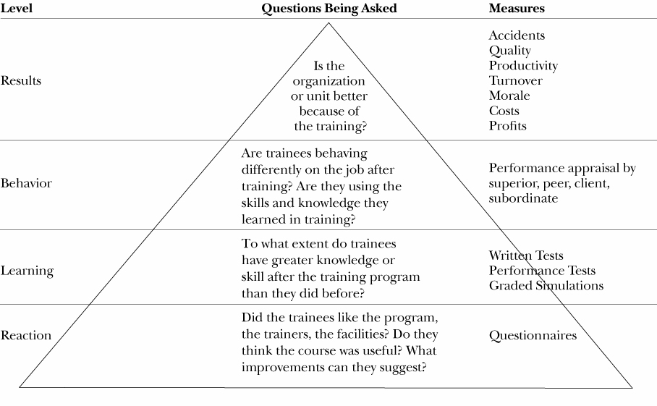
Kirk Patricks Model of Evaluation

Slide 24
Kirk Patricks Model of Evaluation
Reaction – what participants thought of the program, including materials, instructors, facilities, methodology, content etc.
Learning – Learning evaluation is concerned with measuring the extent to which principles, facts, techniques and skills have been acquired.

Slide 25
Kirk Patricks Model of Evaluation
Behavior – behavioral change is measured to determine the extent to which principles, facts, techniques, and skills have been acquired.
Results – evaluation of results involves monitoring organizational improvement such as cost savings, work output changes, and quality changes.

Slide 26
 | evaluation type | evaluation description and characteristics | examples of evaluation tools and methods | relevance and practicability
1 | Reaction | Reaction evaluation is how the delegates felt about the training or learning experience. | 'Happy sheets', or feedback forms. Verbal reaction, post-training surveys or questionnaires. | Quick and very easy to obtain. Not expensive to gather or to analyse.
2 | Learning | Learning evaluation is the measurement of the increase in knowledge - before and after. | Typically assessments or tests before and after the training. Interview or observation can also be used. | Relatively simple to set up; clear-cut for quantifiable skills. Less easy for complex learning.
3 | Behaviour | Behaviour evaluation is the extent of applied learning back on the job - implementation. | Observation and interview over time are required to assess change, relevance of change, and sustainability of change. | Measurement of behaviour change typically requires cooperation and skill of line-managers.
4 | Results | Results evaluation is the effect on the business or environment by the trainee. | Measures are already in place via normal management systems and reporting - the challenge is to relate to the trainee. | Individually not difficult; unlike whole organisation. Process must attribute clear accountabilities.
Kirk Patricks Model of Evaluation

Slide 27
METHODS OF TRAINING
ON-THE JOB(8)
ORIENTATION TRG.
JOB-INSTRUCTION
APPRENTICESHIP
JOB ROTATION
COACHING
MENTORING
INTERNSHIP AND ASSISTANTSHIP
COMMITTEE ASSIGNMENTS.
OFF-THE JOB (11)
VESTIBULE
LECTURES
AUDIO-VISUALS
CONFERENCE
DISCUSSION
CASE STUDY
ROLE PLAY
SIMULATION
PROGRAMMED INSTRUCTIONS/CAI
LABORATORY TRG./SENSITIVITY TRG./T-GROUPS.
E-LEARNING.

Slide 28
Job Instruction Training: The JIT method is a four-step instructional process:
The trainee receives an overview of the job, its purpose and its desired outcomes, with a clear focus on the relevance of training.
b. The trainer demonstrate the job in order to give the employee a model to copy. The trainer show a right way to handle the job.
c . Next, the employee is permitted to copy the trainer’s way. Demonstrations by the trainer and practice by the trainee are repeated until the trainee masters the right way to handle the job.
d. Finally, the employee does the job independently without supervision.
Notes:
It is used primarily to teach workers how to do their current jobs.

Slide 29
Apprenticeship Training:
Technicians and Craft workers such as plumbers, carpenters, lathe operators etc. are trained through formal apprenticeship programmes.
.
Assistantship and internship are similar to apprenticeship because they also demand high level of participation from the trainee.
An Internship is a kind of on-the-job training that combines job training with classroom instruction in trade schools, colleges or universities.

Slide 30
Coaching
Coaching is a kind of daily training and feedback given to employees by immediate supervisors.
In Coaching, the supervisor explains things and answers questions; he throws light on why things are done the way they are; he offers a model for trainees to copy; conducts lot of decision making meetings with trainees; procedures are agreed upon and the trainee is given enough authority to make divisions and even commit mistakes.

Slide 31
Programmed Instruction (PI)
This is a method where training is offered without the intervention of a trainer. PI involves:
Presenting questions, facts, or problems to the learner in a book form or in soft copy.
Allowing the person to respond.
Providing feedback on the accuracy of his/her answers.
If the answers are correct, the learner proceeds to the next block. If not, she/he repeats the same.

Slide 32
OFF-THE-JOB METHODS
Simulation
It is an attempt to create a realistic decision-making environment for the trainee.
Simulations present likely problem situations and decision alternatives to the trainees.
Simulations can range from the simple (creating roles and situational dynamics to help participants briefly “experience” and practice different ways of dealing with situations and consequences) to the more elaborate (organized and planned, but simplified causal chains of situations extending over several days).

Slide 33
The most common methods of Simulations are : Vestibule, Case study, Role playing, Games, and In-basket exercises
Vestibule Training: utilizes equipment which closely resemble the actual ones used on the job.
Case Study: is a written description of an actual situation in business which provokes, in the reader, the need to decide what is going on, what the situation really is or what the problems are, and what can and should be done. Taken from the actual experiences of organizations, cases represent attempts to describe, as accurately as possible, real problems that managers have faced.

Slide 34
III) Role Playing: Generally focuses on emotional (mainly human relations) issues rather than actual ones. It is defined as a method of human interaction that involves realistic behavior in imaginary situations.
The essence of role playing is to create a realistic situation, and then have the trainees assume the parts of specific personalities in the situation.
This method is mostly used for developing interpersonal interactions and relations and also for attitude change.

Slide 35
Behavior Simulation games: These focus primarily on the processes of interpersonal relations, on how decisions are made, and with what consequences, rather than on the substance of the decisions.
In-Basket Exercises: The development of this exercises requires familiarity with the roles participants work on and various styles of memos, letters, and telephone calls. Critical incidences, for inclusion in the “in-basket”, spring from such familiarity.

Slide 36
Lecture Method
This method is a traditional and direct method of instruction. The instructor organizes the material and gives it to a group of trainees in the form of talk.
3. Conference/discussion approach
Trainer delivers a lecture and involves the trainee in a discussion so that his doubts about the job get clarified.
Trainer may use audio-visual aids such as blackboards, slides, video tap or audio tap.

Slide 37
Sensitivity Training
It uses small number of trainees, usually fewer than 12 in a group. They meet with a passive trainer and gain insight into their own and others’ behavior.
Meetings have no agenda, are held away from workplaces, and questions deal with the ‘here and now’ of the group process. Discussion focus on “why participants behave as they do, how they perceive one another, and the feelings and emotions generated in the interaction process.”
The objectives of this training are to provide the participants with increased awareness of their own behaviour and how others perceive them – greater sensitivity to the behaviour of others and increased understanding of group processes.

Slide 38
Cross Functional Training.
Creativity Training.
Diversity Training.
Job/ Skill Training.
Safety/ Literacy Training.
Promotional Training.
Refresher Training.
Remedial Training.

